Slide 1
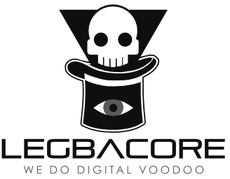
Advanced x86: BIOS and System Management Mode Internals SMM Conclusion
Xeno Kovah && Corey Kallenberg
LegbaCore, LLC

Slide 2
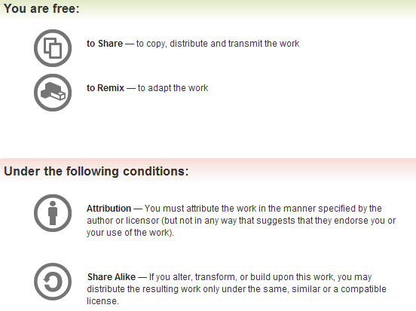
All materials are licensed under a Creative Commons “Share Alike” license.
http://creativecommons.org/licenses/by-sa/3.0/
Attribution condition: You must indicate that derivative work
"Is derived from John Butterworth & Xeno Kovah’s ’Advanced Intel x86: BIOS and SMM’ class posted at http://opensecuritytraining.info/IntroBIOS.html”
Notes:
Attribution condition: You must indicate that derivative work
"Is derived from John Butterworth & Xeno Kovah’s ’Advanced Intel x86: BIOS and SMM’ class posted at http://opensecuritytraining.info/IntroBIOS.html”

Slide 3
SMM Lockdown Summary
Although these may generally only be implemented by the vendor, you can verify most of these
Use TSEG
Ensure entire SMRAM range is contained in the protected space
SMI handler code should not execute code outside the protected memory range
Don’t use interrupts in SMM, unless you explicitly WBINVD the cache before generating an interrupt
Ensure D_LCK is set to lock down both memory-mapping registers as well as SMRAM
Verify SMRR are supported
Verify SMRR are used
Verify SMRR range overlaps/matches TSEG
Verify SMM_LOCK bit is asserted to prevent an attacker from suppressing SMI#
Verify the SMM_BWP bit is set in the BIOS_CNTL register to permit writes to flash only when processor is in SMM

Slide 4
SMM Conclusion
Holds a lot of responsibility in protecting the system
Protects the BIOS flash
Protects itself, because it is instantiated by the BIOS from binary on the BIOS flash
So it is very fragile in case of a writeable BIOS
It is not difficult to locate and “carve” out the SMI code module and replace it with a malicious one
Once written to BIOS the attacker can lock down the once-vulnerable system
Which highlights a general problem with tools like Copernicus. We’ll touch on this at the end of the Trusted Computing section
Bottom line:
If the attacker can write to the BIOS, they can modify SMM (and a lot of other stuff, unlocking protections, etc.)
Therefore, the most important thing to lock down is the SPI Flash, first and foremost.
The protection of which relies first and foremost on SMM

